Slide 1
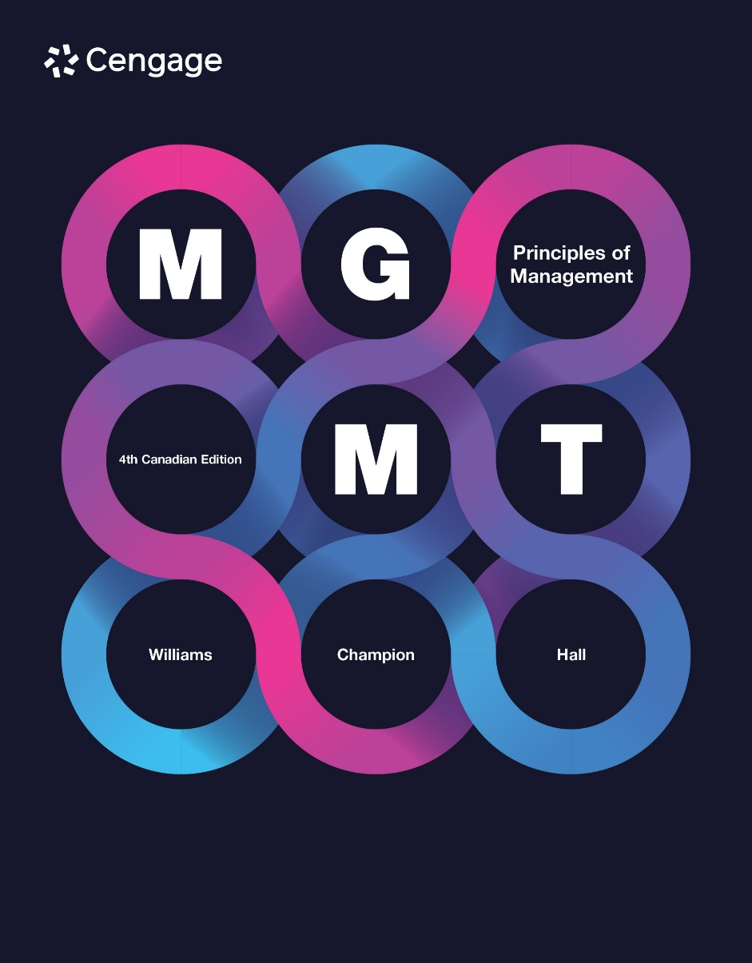

Slide 2
Chapter 13
Leadership
13 Feb 2025
Dr Ike

Slide 3

Leadership
Leadership: the process of influencing others to achieve group or organizational goals
3
13-3
Notes:
How does an ensemble of 100 or more musicians, all playing different parts at different times on different instruments, manage to produce something as beautiful as Beethoven’s Fifth Symphony? The conductor, like a CEO, is responsible for managing all of this complexity and ensuring great output. But his or her job is about much more than keeping the beat with a baton. According to Dr. Ramona Wis, author of The Conductor as Leader, conductors must also build connections between people, inspire them with vision, command their trust, and persuade them to participate in the ensemble at their very best.

Slide 4
Leaders versus Managers
MANAGERS
VS.
LEADERS
Do things right
Focused on productivity and efficiency
Preserve status quo
Short-term perspective
Means (how to get things done)
Control and limit choices of others
Builders
Problem solving
Do the right thing
Focused on vision, mission, goals, and objectives
Promote change and challenge the status quo
Long-term perspective
Ends (what gets done)
Expand people’s choices and options
Architects
Inspiring and motivating
13-4
Notes:
Henry Mintzberg of Montreal’s McGill University spent a lifetime trying to understand what a manager does. His seminal work, The Manager’s Job: Folk Lore and Fact, helped define the difference between management and leadership. Managers make an endless series of decisions about doing things right. Leaders make decisions about doing the right thing.
Leaders are concerned with doing the right thing; managers are concerned with doing things right.
Managers are more concerned with means, how to get things done; leaders are more concerned with ends, what gets done.
Leaders focus on visions, missions, goals, objectives, while managers focus on productivity and efficiency. Managers see themselves as preservers of the status quo; leaders see themselves as promoters of change, as challengers of the status quo in that they encourage creativity and risk taking.
Managers are concerned with control and limiting the choices of others, while leaders are more concerned with expanding people’s choices and options.
Managers solve problems so others can do work, while leaders/managers inspire/motivate others to find their own solutions.
Leaders differ from managers, but organizations need both. Managers are critical to getting out day-to-day work, and leaders are critical to inspiring employees and setting the organization’s long-term direction. A key issue is the extent to which organizations are properly led/managed.

Slide 5
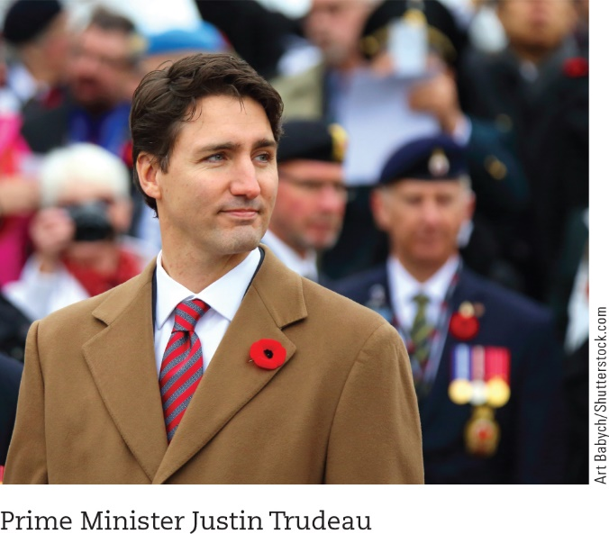
Leadership Traits
Trait theory: a leadership theory that suggests that effective leaders possess a similar set of traits or characteristics
Leadership traits:
Drive
Desire to lead
Honesty and integrity
Self-confidence
Emotional stability
Emotional intelligence
Cognitive ability
Knowledge of the business
13-5
Notes:
Trait theory says that effective leaders possess similar sets of traits/characteristics. Traits are relatively stable characteristics, such as abilities, psychological motives, or consistent patterns of behaviour. Trait theory is also known as “great person” theory because early versions of trait theory stated that leaders are born, not made. Leaders either had the “right stuff” to be a leader or didn’t.
For some time, it was thought that trait theory was faulty and that there are no consistent trait differences between leaders and non-leaders or between effective and ineffective leaders. However, more recent evidence suggests that “successful leaders are not like other people”—that they are indeed different from the rest of us.
According to trait theory, leaders are taller and more confident and have greater physical stamina (i.e., higher energy) than non-leaders. It is noteworthy that 14.5 percent of men are 183 centimetres tall or more, yet 58 percent of Fortune 500 CEOs are taller than that.
Drive: high level of effort characterized by achievement, motivation, initiative, energy, and tenacity
Desire to lead: desire to be in charge and think about ways to influence or convince others about what should or shouldn’t be done
Honesty/integrity: honesty, being truthful with others, is a cornerstone of leadership; integrity is the extent to which leaders do what they say they will do. Leaders may be honest and have good intentions, but they won’t be trusted if they don’t consistently deliver on what they promise.
Self-confidence: Believing in one’s abilities distinguishes leaders from nonleaders. Self-confident leaders are more decisive and assertive and more likely to gain others’ confidence. Self-confident leaders will admit their mistakes because they view them as learning opportunities rather than the refutation of their leadership capabilities.
Emotional stability: Even when things go wrong, leaders remain even-tempered and consistent in their outlook and in the way they treat others. Leaders who can’t control emotions, who anger quickly or attack and blame others for mistakes are unlikely to be trusted.
Emotional intelligence: The ability of people to recognize their own and other people’s emotions, to discriminate between different feelings, and to use emotional information to guide thinking and behaviour.
Cognitive abilities: Don’t mean that leaders are necessarily geniuses but they do mean that leaders have the capacity to analyze large amounts of seemingly unrelated, complex information and see patterns, opportunities, or threats others might not see.
Knowledge of the business: Leaders know their stuff, which means they have superior technical knowledge about the businesses they run. They understand the key technological issues and challenges facing their companies. Studies indicate that more often than not, effective leaders have extensive experience in their industry.

Slide 6
Leadership Behaviours
Initiating structure
Job-centred leadership
Concern for production
Considerate leader behaviour
Employee-centred leadership
Concern for people
13-11
Notes:
Researchers at the University of Michigan, Ohio State University, and the University of Texas examined the specific behaviours that leaders use to improve the satisfaction and performance of their subordinates. Hundreds of studies were conducted and hundreds of leader behaviours were examined. At all three universities, two basic leader behaviours emerged as central to successful leadership: initiating structure (called job-centred leadership at the University of Michigan, and concern for production at the University of Texas), and considerate leader behaviour (called employee-centred leadership at the University of Michigan and concern for people at the University of Texas).
Initiating structure: refers to the degree to which a leader structures the roles of followers by setting goals, giving directions, setting deadlines, and assigning tasks. A leader’s ability to initiate structure primarily affects subordinates’ job performance.
Considerate leader behaviour: refers to the extent to which a leader is friendly, approachable, and supportive, and shows concern for employees. Consideration primarily affects subordinates’ job satisfaction. Specific consideration behaviours include listening to employees’ problems and concerns, consulting with employees before making decisions, and treating employees as equals.

Slide 7
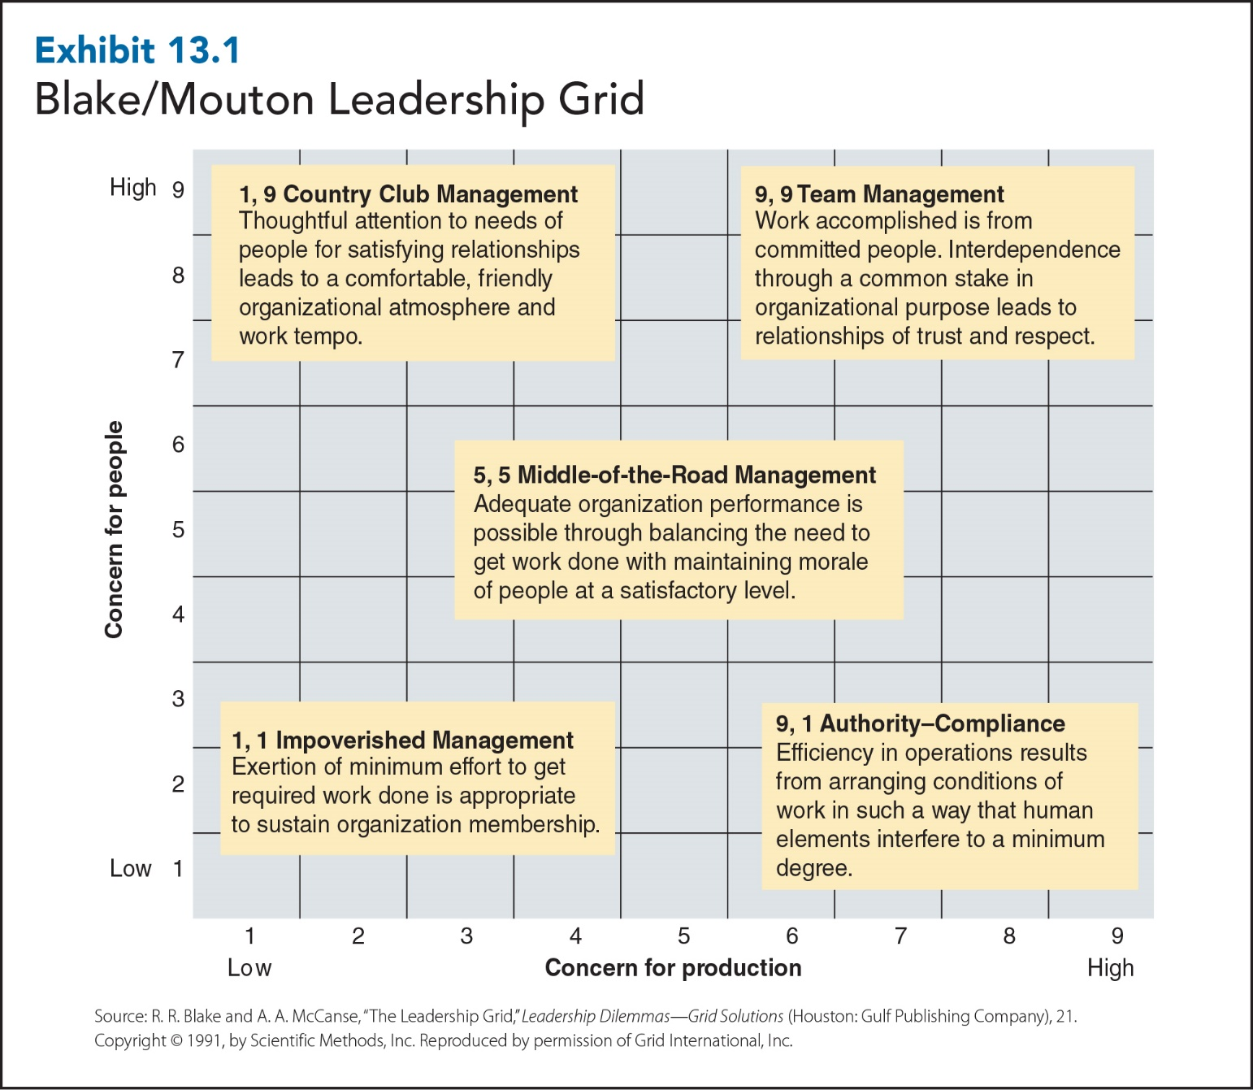
13-7
Notes:
Blake and Mouton used two leadership behaviours—concern for people (i.e., consideration) and concern for production (i.e., initiating structure)—to categorize five different leadership styles. In the exhibit, both behaviours are rated on a 9-point scale, with 1 representing “low” and 9 representing “high.” Blake and Mouton suggest that a “high–high” or 9,9 leadership style is the best. They call this style team management because leaders who use it display a high concern for people (9) as well as a high concern for production (9).
By contrast, leaders use a 9,1 authority–compliance leadership style when they have a high concern for production and a low concern for people. A 1,9 country club style arises when leaders care about having a friendly and enjoyable work environment and don’t really pay much attention to production or performance. Worst of all, according to the grid, is the 1,1 impoverished leader, who shows little concern for people or production and who does the bare minimum necessary to keep his or her job. Finally, the 5,5 middle-of-the-road style develops when leaders show a moderate amount of concern for both people and production.

Slide 8
Situational Approaches to Leadership
Fiedler’s contingency theory
Hersey and Blanchard’s Situational Leadership theory
Path–goal theory
Vroom, Yetton, and Jago’s normative decision model
13-8
Notes:
Leadership style: the way a leader generally behaves toward his/her followers depends on the situation. According to situational leadership theories, there is no one best leadership style. But one of these situational theories differs from the other three in one significant way. Fiedler’s contingency theory assumes that leadership styles are consistent and difficult to change. Therefore, leaders must be placed in or matched to a situation that fits their leadership style. By contrast, the other three situational theories all assume that leaders are capable of adapting and adjusting their leadership styles to fit the demands of different situations.

Slide 9
Fiedler: Situational Favourableness
Situational Favourableness
The degree to which a particular situation either permits or denies a leader the chance to influence the behaviour of group members
Leader–Member Relations
Task Structure
Position Power
13-9
Notes:
Leader–member relations refers to how well followers respect, trust, and like their leaders. When leader–member relations are good, followers trust their leader and there is a friendly work atmosphere.
Task structure refers to when the requirements of a subordinate’s tasks are clearly specified. With highly structured tasks, employees have clear job responsibilities, goals, and procedures.
Position power: Leaders are able to hire, fire, reward, and punish workers. The more influence leaders have over hiring, firing, rewards, and punishments, the greater their power.

Slide 10
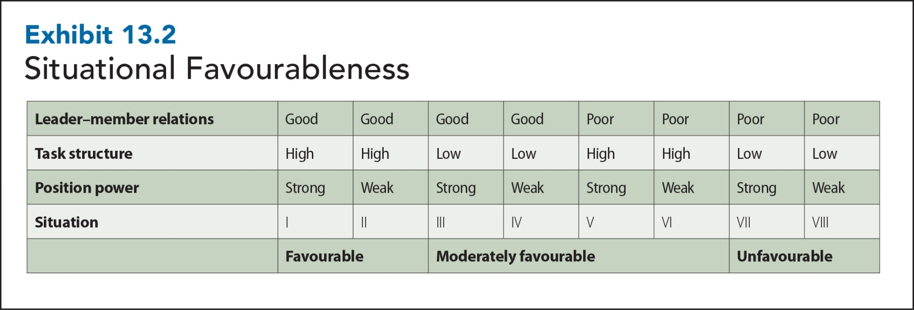
Fiedler: Situational Favourableness
13-10
Notes:
The exhibit shows how leader–member relations, task structure, and position power can be combined into eight situations that differ in favourability to leaders.

Slide 11
Fiedler’s Contingency Theory: Matching Leaders to the Right Situation
Assess leaders in terms of the conduct and performance of the people they are leading.
Leaders are generally unable to change their style and they are more effective when that style fits the situation.
The success of a leader depends on the degree to which he or she is able to influence the behaviour of group members.
11
13-11
Notes:
Fiedler’s contingency theory states that in order to maximize work group performance, leaders must be matched to the right leadership situation. The first basic assumption of Fiedler’s theory is that leaders are effective when the work groups that are led perform well. So, instead of judging leaders’ effectiveness by what the leaders do (i.e., initiating structure and consideration) or by who they are (i.e., trait theory), Fiedler assesses leaders in terms of the conduct and performance of the people they are leading. Second, Fiedler assumes that leaders are generally unable to change their style and that they are more effective when that style fits the situation. Third, he assumes that the success of a leader depends on the degree to which he or she is able to influence the behaviour of group members. Note that it is the group behaviour and not the leader behaviour we are talking about here. In other words, besides traits, behaviours, and a favourable situation, leaders need the group’s “permission” to lead.

Slide 12
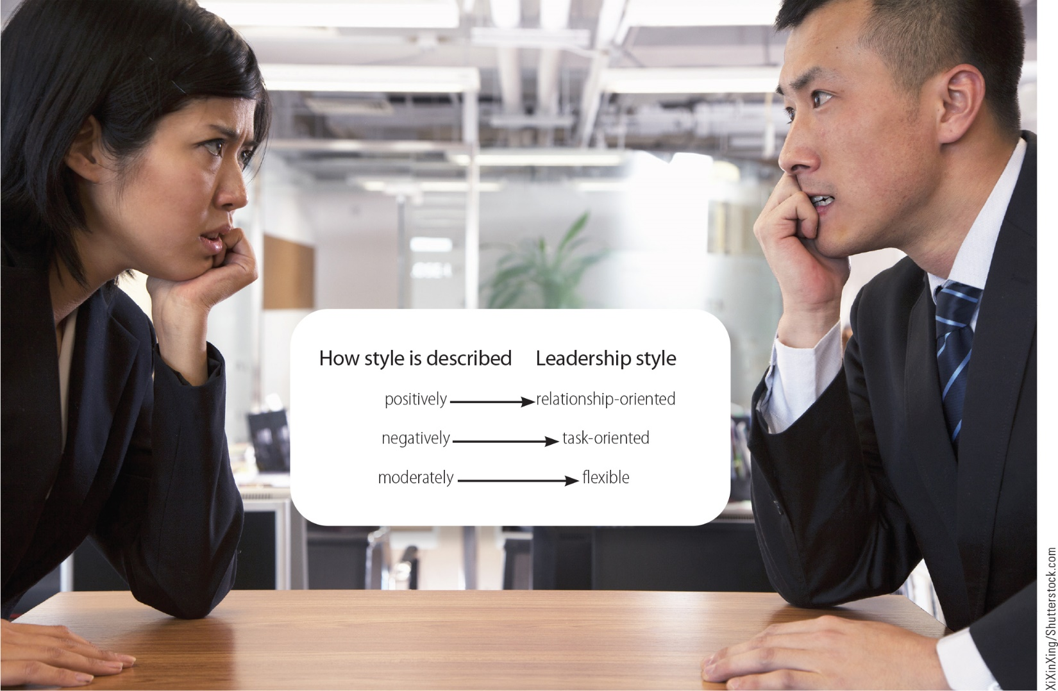
Fiedler’s Leadership Style

Slide 13
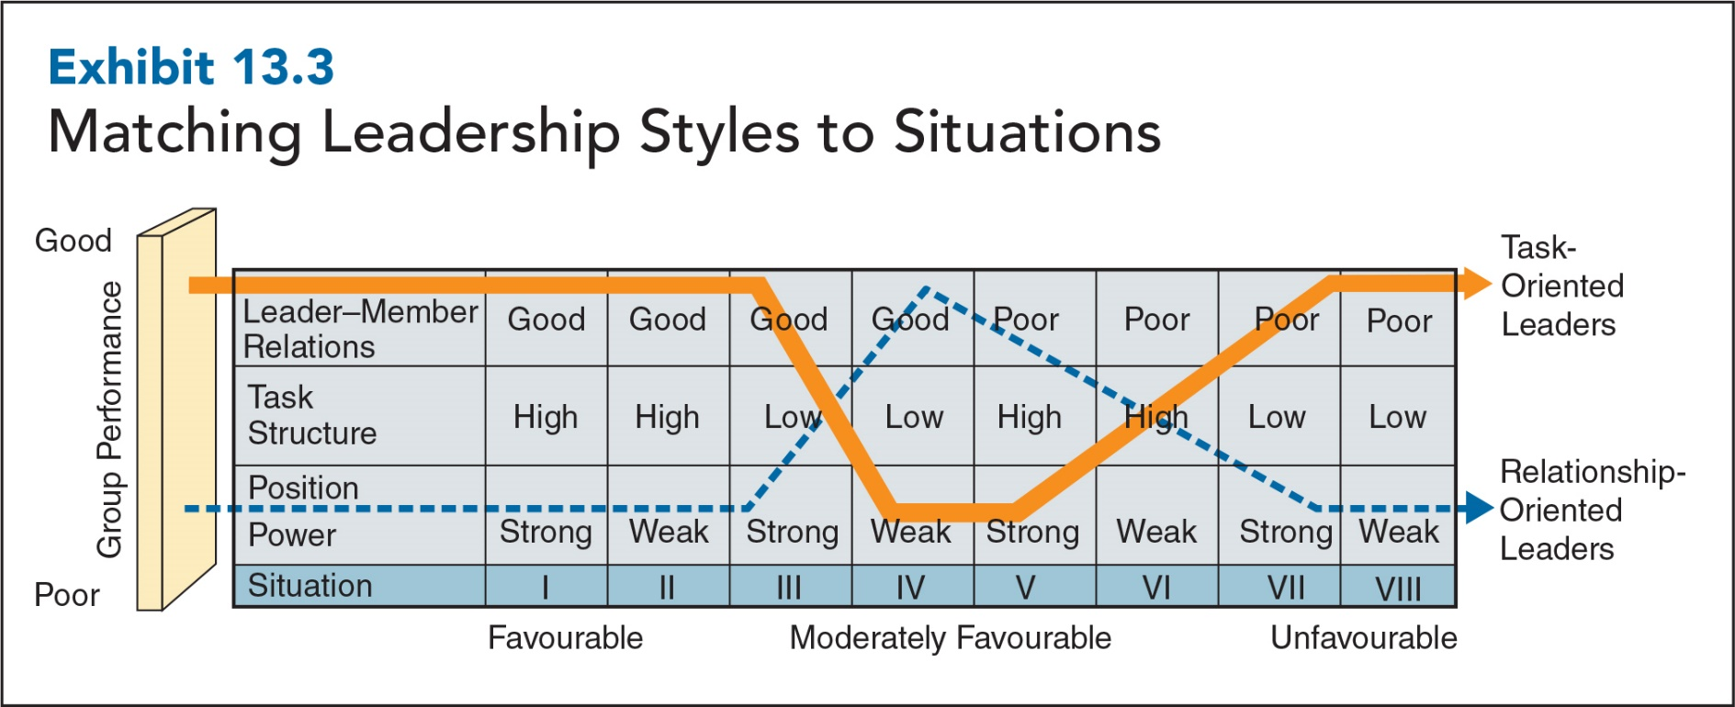
Fiedler: Matching Leadership Styles to Situations
13-13
Notes:
Fiedler assumes that leaders are generally incapable of changing leadership styles.
People who describe a least-preferred coworker in a positive way (scoring 64 and above on the full inventory of 18 oppositional pairs) have relationship-oriented leadership styles. If they can still be positive about a least-preferred coworker, they must be people-oriented.
People who describe a least-preferred coworker in a negative way (scoring 57 or below) have task-oriented leadership styles. Given a choice, they’ll focus first on getting the job done and then making sure everyone gets along.
Those with moderate scores (from 58 to 63) have a more flexible leadership style and can be somewhat relationship-oriented and somewhat task-oriented.
After studying thousands of leaders and followers in hundreds of different situations, Fiedler found that the performances of relationship- and task-oriented leaders followed the pattern shown in the exhibit.

Slide 14
Hersey and Blanchard: Situational Leadership Theory
Situational Leadership Theory:
Based on the idea of follower readiness
Employees have different levels of readiness for handling different jobs, responsibilities, and work assignments
Worker readiness
Job readiness: amount of knowledge, skill, ability people have to perform their jobs
Psychological readiness: feeling of self-confidence and respect
13-14
Notes:
Job readiness consists of the amount of knowledge, skill, ability, and experience people have to perform their jobs. As you would expect, people with greater skill, ability, and experience do a better job of supervising their own work.
Psychological readiness, on the other hand, is a feeling of self-confidence or self respect. Confident people do a better job of guiding their own work than do insecure people.
Job readiness and psychological readiness are combined to produce four different levels of readiness in Hersey and Blanchard’s Situational Leadership theory:
The lowest level, R1, represents insecure people who are neither willing nor able to take responsibility for guiding their own work.
R2 represents people who are confident and are willing but not able to take responsibility for guiding their own work.
R3 represents people who are insecure and are able but not willing to take responsibility for guiding their own work.
R4 represents people who are confident, willing, and able to take responsibility for guiding their own work. It’s important to note that a follower’s readiness is usually task specific. For example, you may be highly confident and capable when it comes to social media marketing but know nothing about setting up budgets for planning purposes. Thus, you would possess readiness (R4) with respect to social media marketing but not (R1) with respect to budgets.

Slide 15
Situational Leadership: Leadership Styles
Telling – based on one-way communication, in which followers are told what, how, when, and where to do particular tasks
Selling – involves two-way communication and psychological support to encourage followers to “own” or “buy into” particular ways of doing things
Participating – based on two-way communication and shared decision-making
Delegating – used when leaders basically let workers “run their own show” and make their own decisions
13-15
Notes:
Similar to Blake and Mouton’s managerial grid, situational theory defines leadership styles in terms of task behaviour (that is, concern for production) and relationship behaviour (that is, concern for people). As seen above, these two behaviours can be combined to form four different leadership styles: telling, selling, participating, and delegating. Leaders choose one of these styles, depending on the readiness a follower has for a specific task.
A telling leadership style (high task behaviour and low relationship behaviour) is based on one-way communication, in which followers are told what, how, when, and where to do particular tasks. Telling is used when people are insecure and neither willing nor able to take responsibility for guiding their own work (R1).
A selling leadership style (high task behaviour and high relationship behaviour) involves two-way communication and psychological support to encourage followers to “own” or “buy into” particular ways of doing things. Selling is used when confident people are willing but not able to take responsibility for guiding their own work (R2).
A participating style (low task behaviour and high relationship behaviour) is based on two-way communication and shared decision-making. Participating is used when insecure people are able but not willing to take responsibility for guiding their own work (R3).
A delegating style (low task behaviour and low relationship behaviour) is used when leaders basically let workers “run their own show” and make their own decisions. Delegating is used when people are willing and able to take responsibility for guiding their own work (R4).

Slide 16
Adapting Leader Behaviour: Path–Goal Theory
Path–Goal Theory:
Leaders can increase subordinate satisfaction and performance by clarifying and clearing the paths to goals and by increasing the number and kinds of rewards available for goal attainment.
Leader’s behaviour must be a source of immediate or future satisfaction for followers.
Leaders must offer uniqueness and value beyond what followers already experience.
13-16

Slide 17
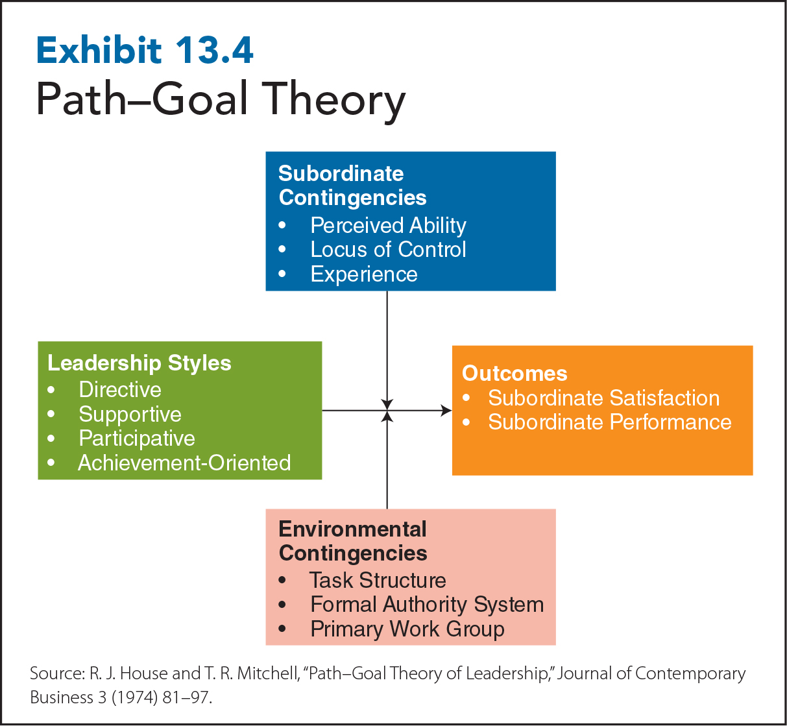
13-17
Notes:
Path– Goal Theory: Leadership Styles
Directive leadership: a leadership style where the leader lets employees know what is expected of them, gives specific guidelines for performing tasks, schedules work, sets standards of performance, and makes sure people follow the standard rules and regulations
Supportive leadership: a leadership style in which the leader is friendly and approachable, shows concern for employees and their welfare and treats them as equals, and creates a friendly climate
Participative leadership: a leadership style in which the leader consults employees for suggestions and input before making decisions
Achievement-oriented leadership: a leadership style in which the leader sets challenging goals, has high expectations of employees, and displays confidence so that employees will assume responsibility and put in extraordinary effort

Slide 18
Subordinate and Environmental Contingencies
Subordinate contingencies
Perceived ability
Locus of control
Experience
Environmental contingencies
Task structure
Formal authority system
Primary work group
13-18
Notes:
Subordinate Contingencies Perceived ability: how much ability subordinates believe they have for doing jobs well. Subordinates who perceive they have a great deal of ability will be dissatisfied with directive leader behaviours. Experienced employees are likely to react in a similar way. They already know how to do their jobs (or perceive they do) and don’t need or want close supervision. Subordinates with little experience or perceived ability will welcome directive leadership.
Locus of control: personality measure that indicates the extent to which people believe they have control over what happens to them in life. Internals believe what happens to them, good/bad, is a result of their choices and actions. Externals, on other hand, believe that what happens to them is caused by external forces beyond their control.
Environmental Contingencies
Task structure: degree to which the requirements of a subordinate’s tasks are clearly specified. When task structure is low and tasks are unclear, directive leadership should be used because it complements the work environment.
Formal authority system: an organization’s set of procedures, rules, and policies. When a formal authority system is unclear, directive leadership complements the situation by reducing uncertainty or increasing clarity. When a formal authority system is clear, directive leadership is redundant and should not be used.
Primary work group: refers to the amount of work-oriented participation or emotional support that is provided by an employee’s immediate work group. Participative leadership should be used when the tasks are complex and there is little existing work-oriented participation in the primary work group.

Slide 19
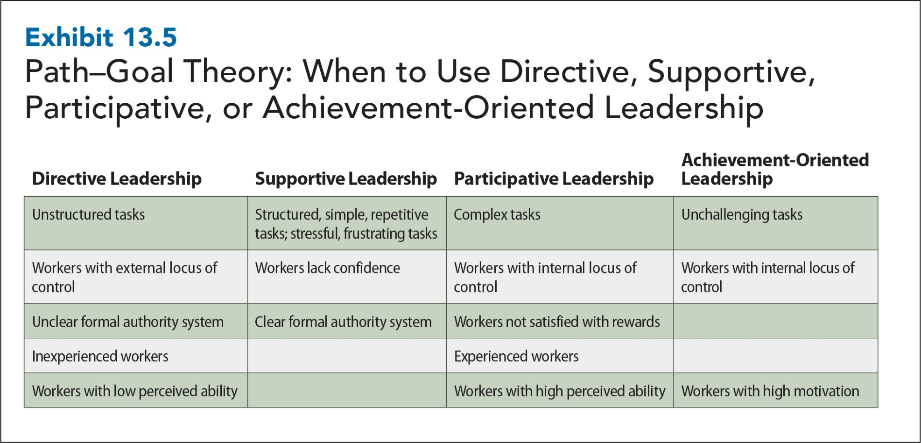
13-19
Notes:
The exhibit provides a summary of when directive, supportive, participative, and achievement-oriented leadership styles should be used.

Slide 20
Normative Decision Theory
The Vroom-Yetton-Jago Model
Theory that suggests how leaders can determine an appropriate amount of employee participation when making decisions
Specifies 5 different decision styles, or ways of making decisions:
Autocratic (AI or AII)
Consultative (CI or CII)
Group (GII)
Using the right degree of employee participation improves the quality of decisions and the extent to which employees accept and are committed to decisions

Slide 21
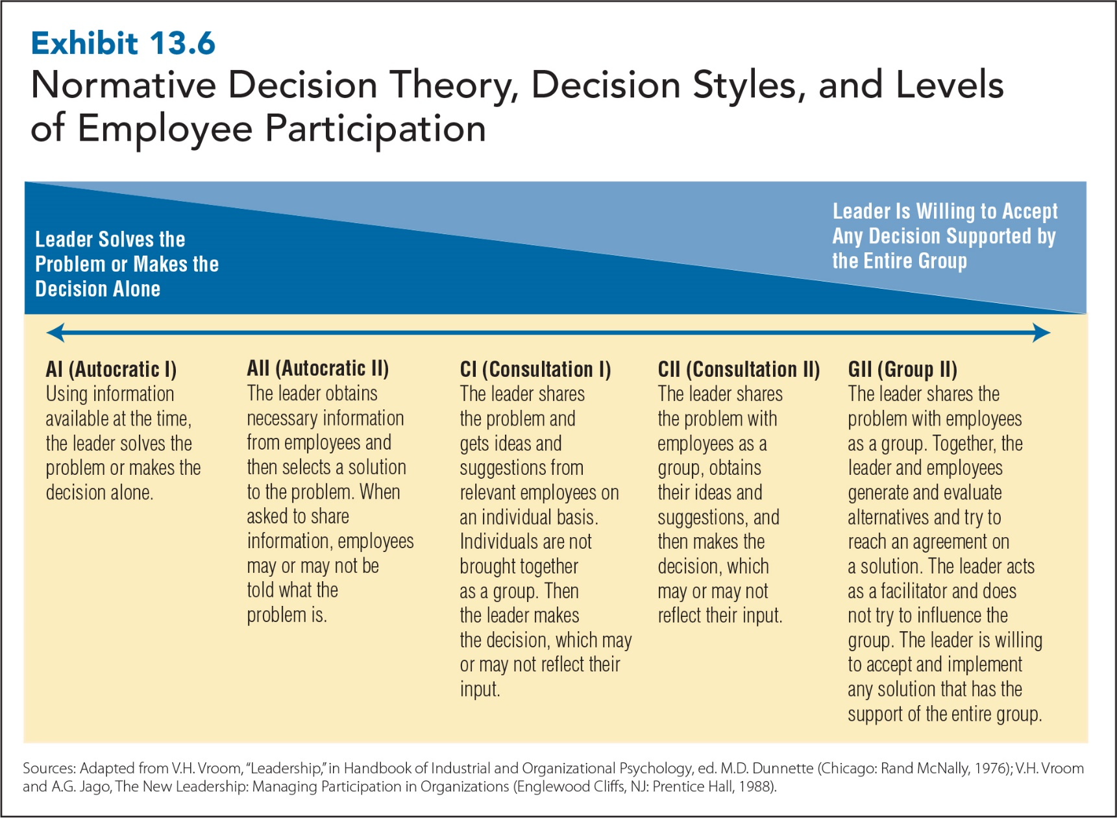
13-21
Notes:
Autocratic (AI or AII)
Leaders make the decisions.
Consultative (CI or CII)
Leaders share the problems; then they make the decisions themselves.
Group (GII)
Leaders share the problems; then they have the group make decisions.

Slide 22
Normative Theory Decision Rules
Decision Rules to Increase Decision Quality
Quality Rule
Leader Information Rule
Subordinate Information Rule
Goal Congruence Rule
Problem Structure Rule
Decision Rules to Increase Decision Acceptance
Commitment Probability Rule
Subordinate Conflict Rule
Commitment Requirement Rule
Sources: Adapted from V. H. Vroom, “Leadership” in Handbook of Industrial and Organizational Psychology, ed. M. D. Dunnette (Chicago: Rand McNally, 1976); V. H. Vroom and A. G. Jago, The New Leadership: Managing Participation in Organizations (Englewood Cliffs, NJ: Prentice Hall, 1988).)
Notes:
Quality rule: If the quality of the decision is important, don’t use autocratic decision style.
Leader information rule: If the quality of the decision is important or if the leader doesn’t have enough information to make the decision on his/her own, don’t use autocratic decision style.
Subordinate information rule: If the quality of the decision is important and if subordinates don’t have enough information to make the decision themselves, don’t use group decision style.
Goal congruence rule: If the quality of the decision is important and subordinates’ goals are different from the organization’s goals, don’t use group decision style.
Problem structure rule: If the quality of the decision is important, the leader doesn’t have enough information to make the decision on his/her own, and the problem is unstructured, don’t use autocratic decision style.
Commitment probability rule: If having subordinates accept and commit the decision is important, don’t use autocratic decision style.
Subordinate conflict rule: If having subordinates accept and commit to the decision is important and critical to the successful implementation and subordinates are likely to disagree or end up in conflict over the decision, don’t use autocratic or consultative decision style.
Commitment requirement rule: If having subordinates accept the decision is absolutely required for the successful implementation and subordinates share the organization’s goals, don’t use autocratic or consultative style.

Slide 23
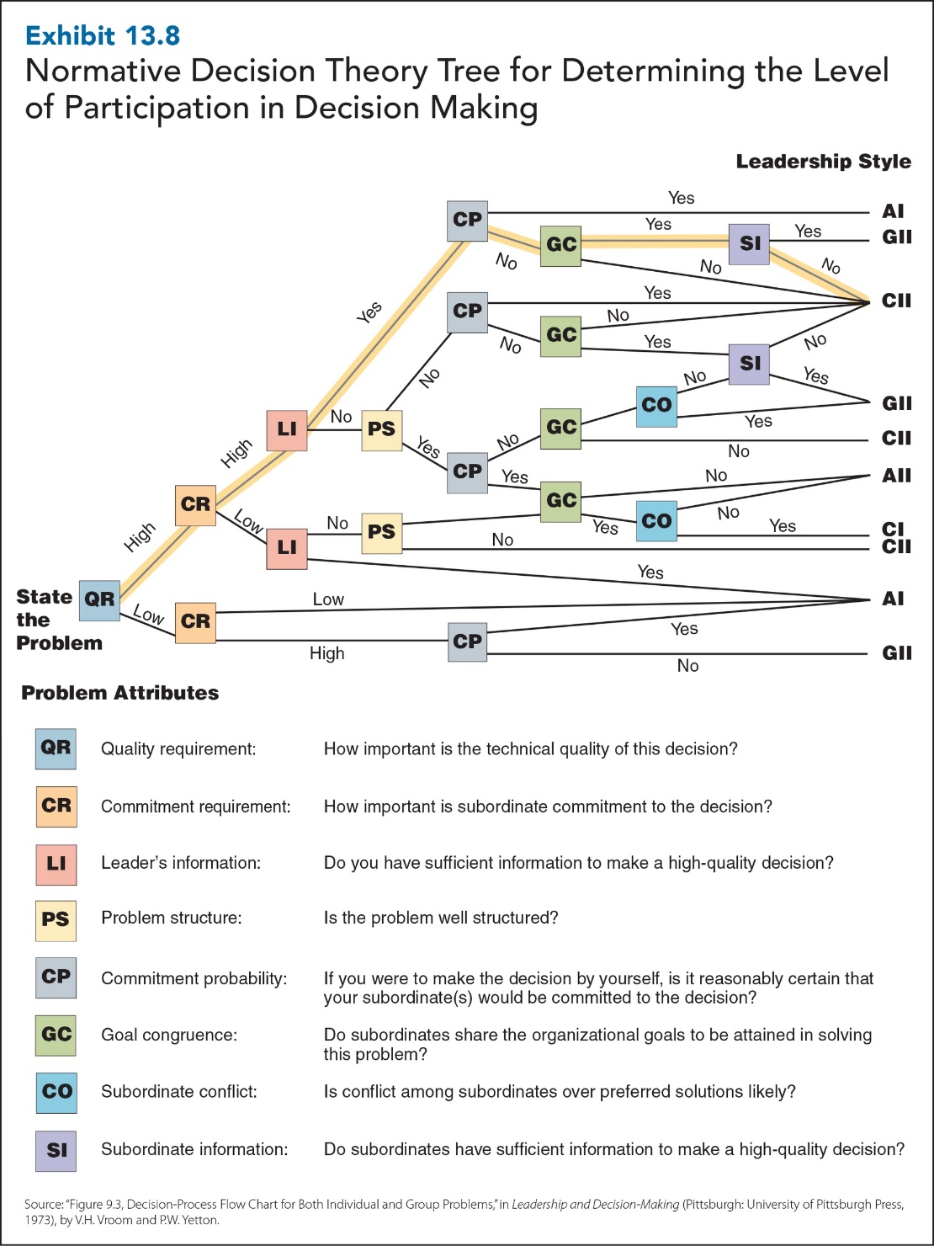
13-23
Notes:
Problem Attributes
QR Quality requirement: How important is the technical quality of this decision?
CR Commitment requirement: How important is subordinate commitment to the decision?
LI Leader’s information: Do you have sufficient information to make a high-quality decision?
PS Problem structure: Is the problem well structured?
CP Commitment probability: If you were to make the decision by yourself, is it reasonably certain that your subordinate(s) would be committed to the decision?
GC Goal congruence: Do subordinates share the organizational goals to be attained in solving this problem?
CO Subordinate conflict: Is conflict among subordinates over preferred solutions likely?
SI Subordinate information: Do subordinates have sufficient information to make a high-quality decision?

Slide 24
Strategic Leadership
Strategic Leadership
The ability to
anticipate
envision
maintain flexibility
think strategically
work with others
initiate changes
create a positive future
13-24

Slide 25
Visionary Leadership
Creates a positive image of the future that motivates organizational members and provides direction for future planning and goal setting.
13-25

Slide 26
Visionary Leadership
Charismatic Leadership
Transformational Leadership
13-26
Notes:
Charismatic leadership: behavioural tendencies and personal characteristics of leaders create exceptionally strong relationship between them and their followers
Transformational leadership: generates awareness and acceptance of a group’s purpose and mission and gets employees to see beyond their own needs and self-interests for the good of the group.

Slide 27
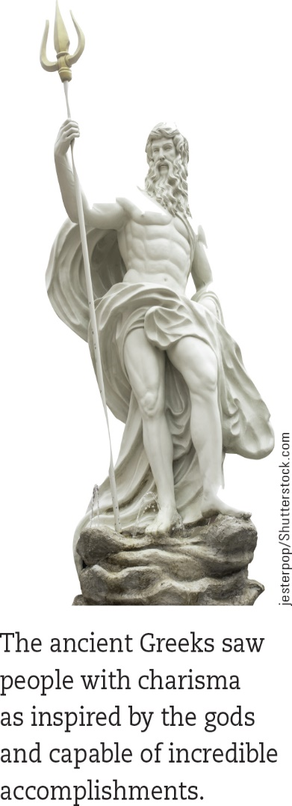
Charismatic Leadership
Creates an exceptionally strong relationship
Articulates a clear vision
Models values consistent with that vision
Communicates high-performance expectations
Strong, confident, dynamic personalities
Establishes trust and loyalty from followers
Concern is with ego-driven charismatic leaders who take advantage of fanatical followers
13-27
Notes:
The ancient Greeks saw people with charisma as inspired by the gods and capable of incredible accomplishments.

Slide 28
Visionary Leadership: Transformational Leadership
Transformational Leadership
Charismatic Leadership
Inspirational Motivation
Intellectual Stimulation
Individualized Consideration
13-28
Notes:
Charismatic leadership involves articulating a clear vision, modelling values consistent with that vision, communicating high performance expectations, and establishing very strong relationships with followers. Transformational leadership goes even further than this by generating awareness and acceptance of a group’s purpose and mission and by getting employees to see beyond their own needs and self-interest for the good of the group. Like charismatic leaders, transformational leaders are visionary, but they transform their organizations by getting their followers to accomplish more than they intended and even more than they thought possible. Transformational leaders practise charismatic leadership or idealized influence by acting as role models for their followers. Because transformational leaders put others’ needs ahead of their own and share risks with their followers, they are admired, respected, and trusted, and followers want to emulate them.
Inspirational motivation: Transformational leaders motivate and inspire followers by providing meaningful and challenging work. By communicating expectations and demonstrating commitment to goals, transformational leaders help followers envision the future. This leads to greater enthusiasm and optimism about the future.
Intellectual stimulation: Transformational leaders encourage followers to be creative and innovative, to question assumptions, and to look at problems and situations in new ways even if their ideas are different from those of the leader.
Individualized consideration: Transformational leaders pay special attention to followers’ individual needs by creating learning opportunities, accepting and tolerating individual differences, encouraging two-way communication, and being good listeners.

Slide 29
Transformational vs. Transactional Leadership
Transformational Leadership
Transactional Leadership
Transformational leadership uses visionary and inspirational appeals to influence followers.
Transactional leadership is based on an exchange process in which followers are rewarded for good performance and punished for poor performance.

